Slide 1

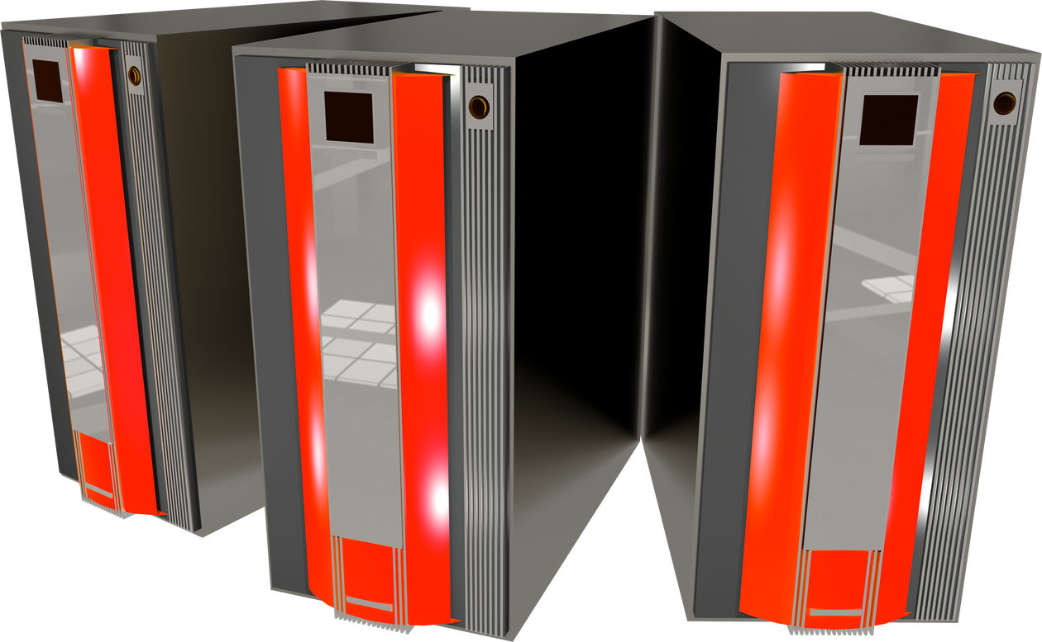
PROXY VS
REVERSE PROXY
By Hussein Nasser

Slide 2

What is a Proxy?
I want to go to google.com through
proxy: my-proxy.com
my-proxy.com
google.com
I just know that I received a request from my-proxy

Slide 3



PROXY USE CASES
Caching
Anonymity
Logging
Block Sites
Microservices

Slide 4
What is a Reverse Proxy?
google-server1
I want to go to google.com
google.com
google-server2

Slide 5



REVERSE PROXY USE CASES
Caching
Load Balancing
Ingress
Canary Deployment
Microservices

Slide 6

MOST COMMON QUESTIONS
Can Proxy & Reverse Proxy used in the same time?
Can I use Proxy instead of VPN for annomity?
Is Proxy just for HTTP traffic?

